Slide 1
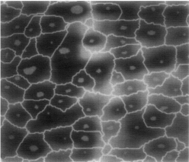
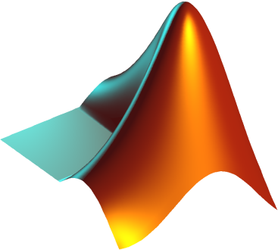
Image
Analysis
Meyer F, Beucher S (1990) Journal of Visual Communication and Image Representation

Slide 2


Controlling Program
FILES
Return
Capstone_files
5-29-13-202203
5-28-13-123456
5-27-13-141414

Slide 3
Direction
Detachment research
How can we detach cells while preserving apoptotic and necrotic stages?
What is the ideal combination of detachment steps?
Use suspension cells to test
Assay comparison
Compare DDA and FHA
Find ideal combination
Image clarity
Procedure speed
Software Development
Image algorithms (MATLAB)
Apoptotic, necrotic, live cells
Apoptotic index
DNA damage (halo moment)
Controlling program (Python)
Select and run algorithms
Compare results
File I/O
GUI (Kivy)
Manage & present data
User input tools

